Slide 1
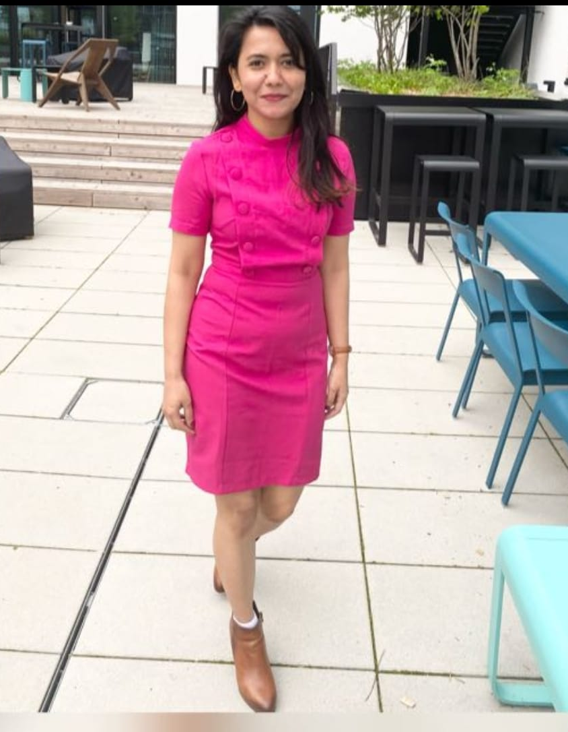
Presentation title

Slide 2
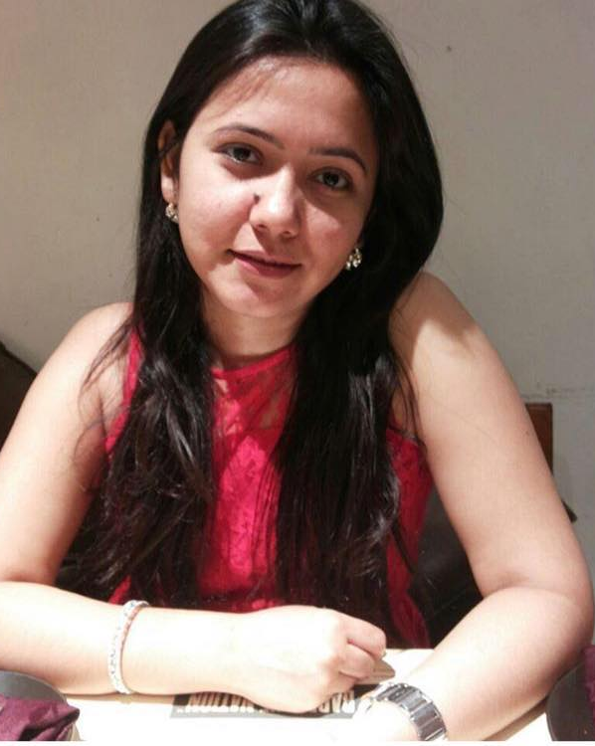
ABOUT SHUBHANGI
Born in northern California and raised in a family of artists, Sam has been taking pictures for as long as she can remember.
Her unique style, extensive training, and deep appreciation for her subjects makes her photographs a joy to look at.

Slide 3

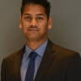

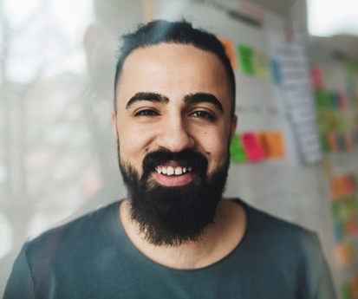
Meet our team
Natasa Pahor
Gopal Ponna
Manjushree
Debapriya Dawn
Product Owner
Solution Architect
Scrum Master
Associate Manager

Slide 4
Meet our team
Natasa Pahor
Gopal Ponna
Manjushree
Debapriya Dawn
Product Owner
Solution Architect
Scrum Master
Associate Manager

Slide 5
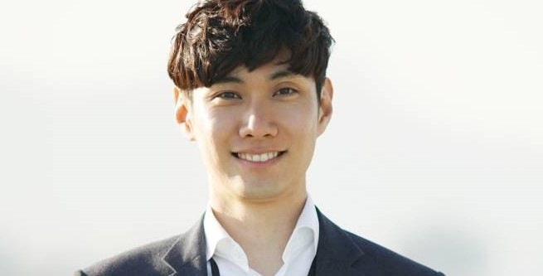
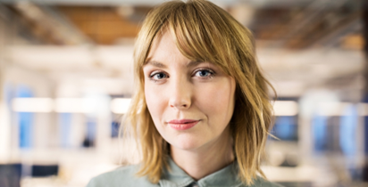

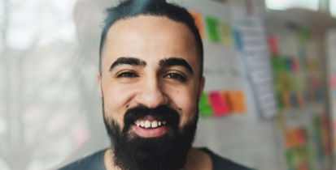




Meet our extended team
Meenakshi
Rahul Chaudhary
Saraswati Thakur
Mamata Mahesh
President
Chief Executive Officer
Chief Operations Officer
VP Marketing
Khadar paligiri
Manasa Mundas
Ana galego
Bhargav
VP Product
SEO Strategist
Product Designer
Content Developer

Slide 6
Meet our extended team
Meenakshi
Rahul Chaudhary
Saraswati Thakur
Mamata Mahesh
President
Chief Executive Officer
Chief Operations Officer
VP Marketing
Khadar palagiri
Manasa Mundas
Ana galego
Bhargav
VP Product
SEO Strategist
Product Designer
Content Developer

Slide 7
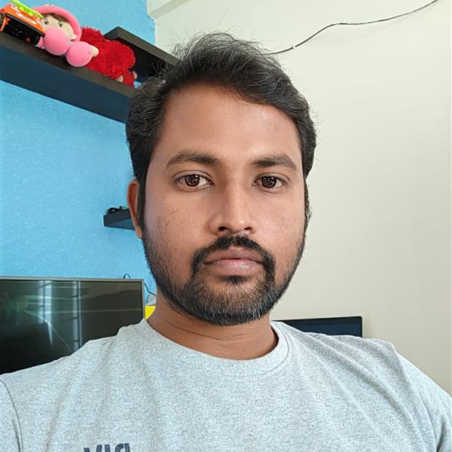
We still cannot believe that you will be leaving us. I pray that you achieve great successes in your new position. Good luck and please keep in touch.
Khadar palagiri

Slide 8
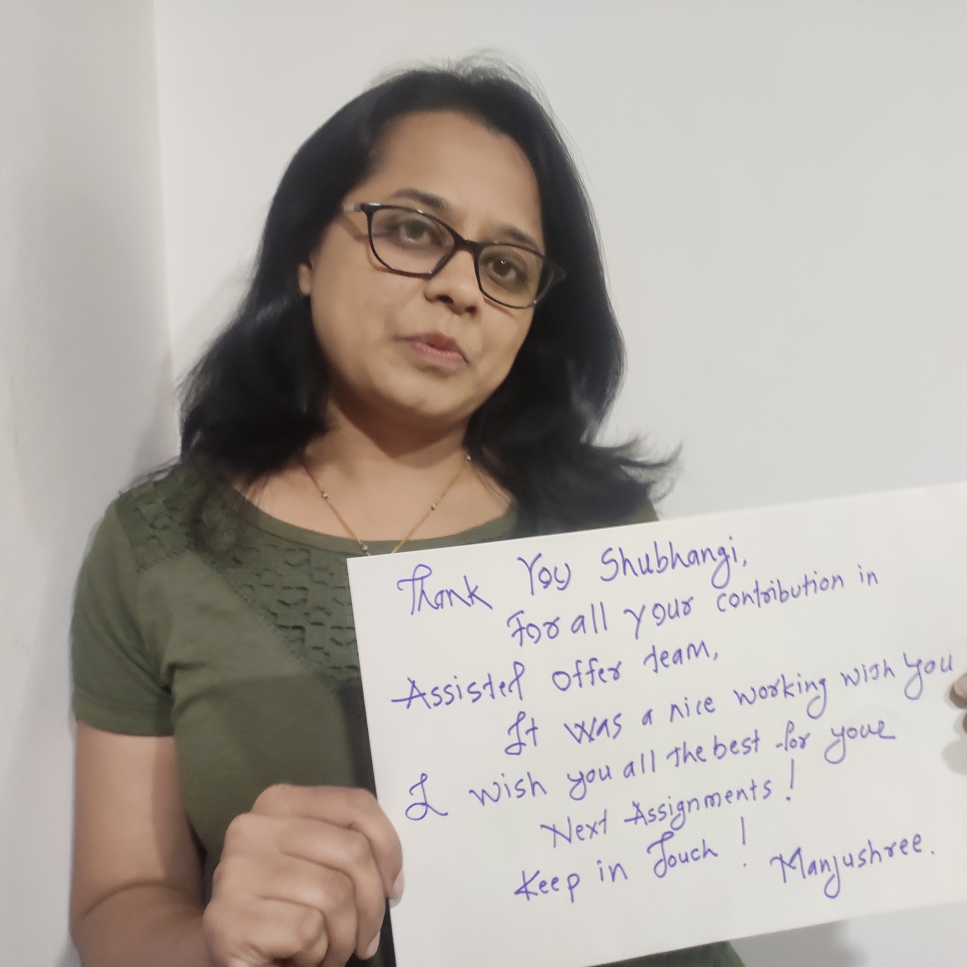
Thank you for all your contributions in Assisted Offer team, it was very a nice working with you, I wish you All the Best for your next assignments!! keep in touch!!
Manjushree

Slide 9
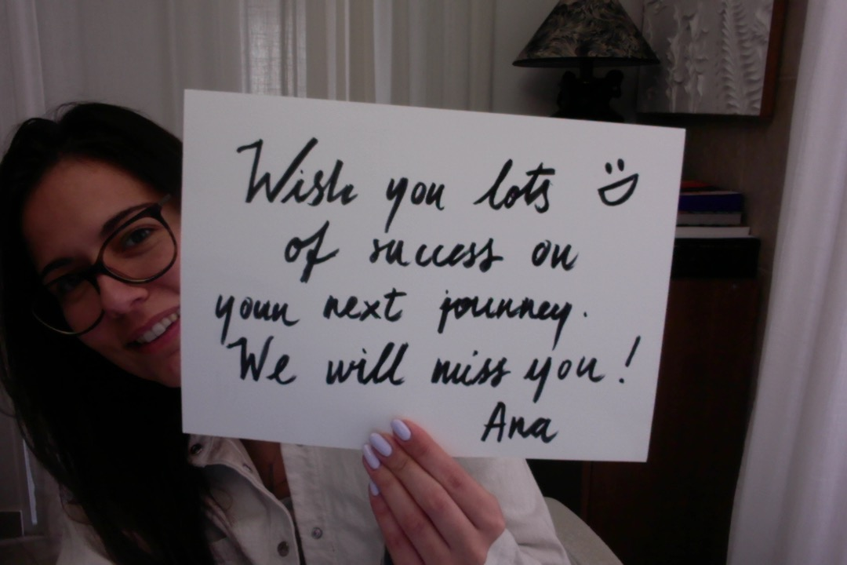

Wish you lots of success on your next journey. We will miss you
Ana Galego

Slide 10


Fraud Checks won’t be same without you!!! Thank you for the amazing job! We will miss you!
Natasa Pohar

Slide 11
We still cannot believe that you will be leaving us. I pray that you achieve great successes in your new position. Good luck and please keep in touch.
Khadar palagiri

Slide 12
Business opportunities are like buses. There’s always another one coming.
“
”
Richard Branson

